Slide 1
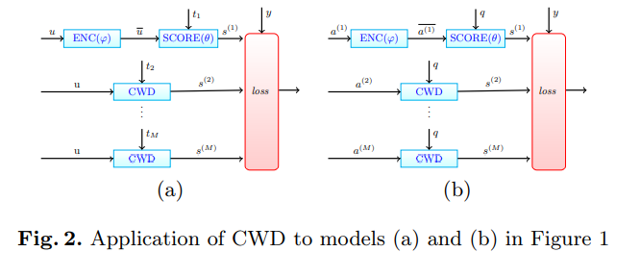
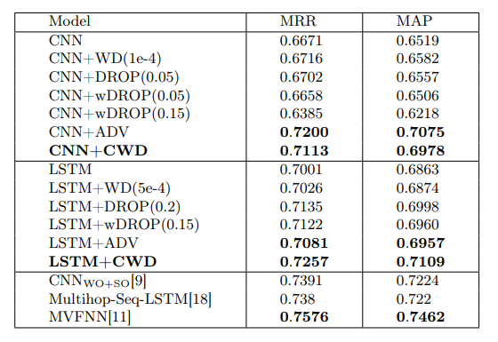
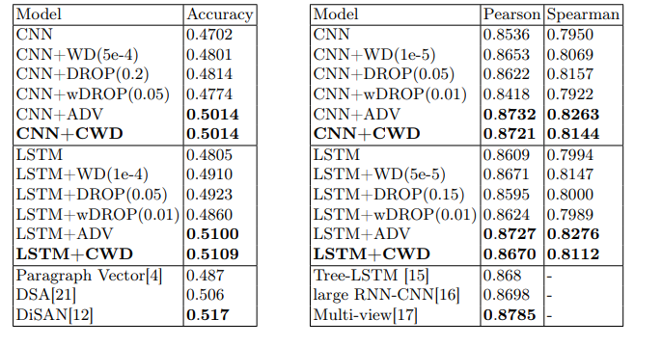
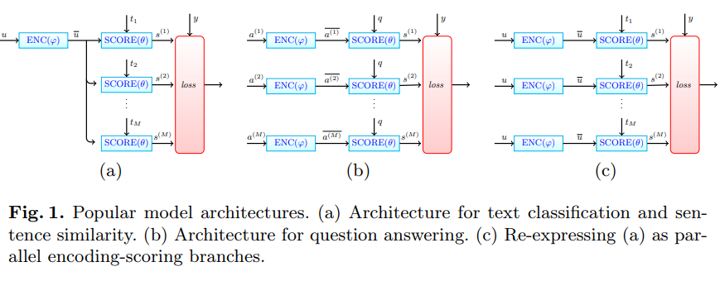
Regularizing Deep Text Models By Encouraging Competition
CCKS2022
Jiaran Li， Richong Zhang，Yuan Tian
Beihang University
Introduction
Despite the great successes in such practice, supervised text learning using neural networks is significantly challenged， effective regularization techniques are highly desirable in text learning.
Inspired by the great needs of regularization techniques for text learning as well as their semantic interpretability, this paper proposes a new regularization scheme, which we call Competitive Word Dropout, or CWD in short
we formally develop the CWD regularization scheme, and demonstrate its use in three different supervised learning tasks: question-answering text classification, and semantic relatedness prediction
The performance of CWD appear to level with adversarial training applied to the word embeddings. Comparing with adversarial training, however, CWD has better interpretability.
Method
The input sentence (or document) is first encoded using a neural network, and then scored based on each target. We call such a component an encoding-scoring branch . Specifically, an encoding-scoring branch is a composition of an encoding function ENC with learnable parameter φ and a scoring function SCORE with learnable parameter θ.
The function ENC encodes the input sentence (or document) to a vector
The objective of SCORE is to evaluate how well the encoding fits the target.
The key function of NEGLECT is to remove some useless words with respect to the target
CWD can be applied as follows: Replace each negative encoding-scoring branch by its corresponding CWD module, which concatenates the word-neglecting component, the encoding component ENC and scoring component SCORE.
Experiment Results
Question Answering
Sentiment Analysis
Semantic Relatedness Prediction
作者联系
方式
lijr1993@buaa.edu.cn
2022全国知识图谱与语义计算大会
China Conference on Knowledge Graph and Semantic Computing
秦皇岛 8.24-8.27

